Slide 1


PRISONER INFORMATION PORTAL
Presented By -
V. Lakshmi Revanth Kumar
Batch – PGDEA 83

Slide 2


CONTENTS
Introduction
Objective
Flowchart
Use Case Diagram
Features
Applications
Results
Conclusion

Slide 3
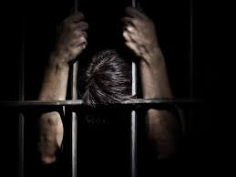
INTRODUCTION
The Prisoner Information Portal is a software initiative that streamlines police station operations by efficiently managing case files. It provides a user-friendly interface for police staff, enabling quick access to essential information and improving overall workflow.
The purpose of this system is to maintain records about the inmates. As a user, Jailor can log in and add information on inmates, such as their name, age, offence, and sentence.

Slide 4



OBJECTIVE
To design and develop a secure, user-friendly platform for managing prisoner records, enabling efficient monitoring, easy data access, and reporting, while safeguarding the security and integrity of information.

Slide 5
Start
FLOWCHART
Login
Login Credentials File
Login Successful?
In case login failed, after three attempts, It show’s Too many failed attempts. Exiting...
NO
Yes
Display Menu
Add Record
Search Record
Edit Record
Delete Record
View Record
File Operations
The Information Stored in both Text File & Binary File.
Exit

Slide 6
USE CASE DIAGRAM
Login
Add Record
Search Record
Admin
Data Stored in File
Edit Record
Delete Record
View Record

Slide 7
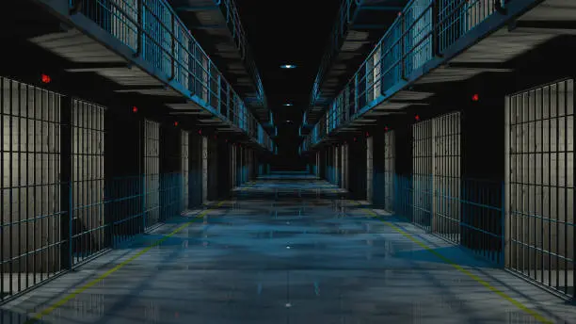
FEATURES
Secure Login System
Efficient Record Management
Data Storage
User-Friendly Interface

Slide 8

APPLICATIONS
Inmate Management
Visitor Management
Security and Surveillance
Healthcare Management
Legal and Case Management

Slide 9
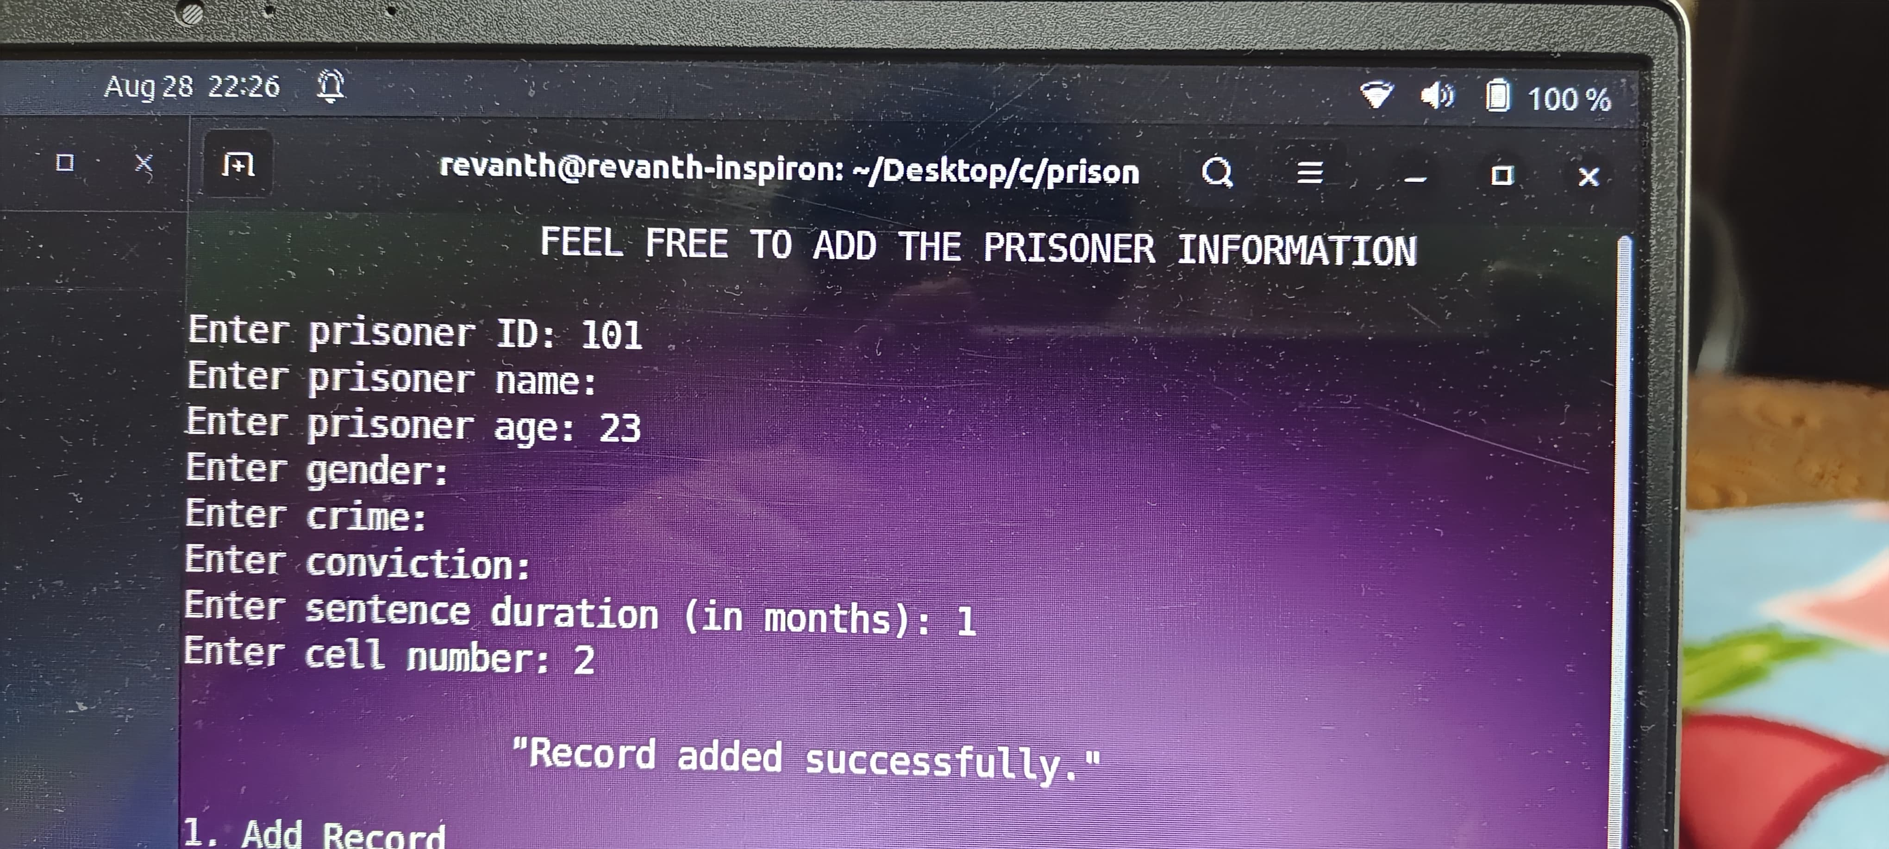
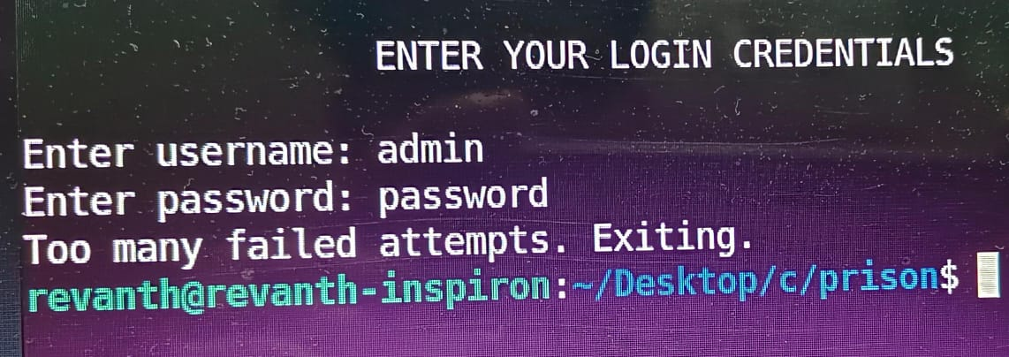
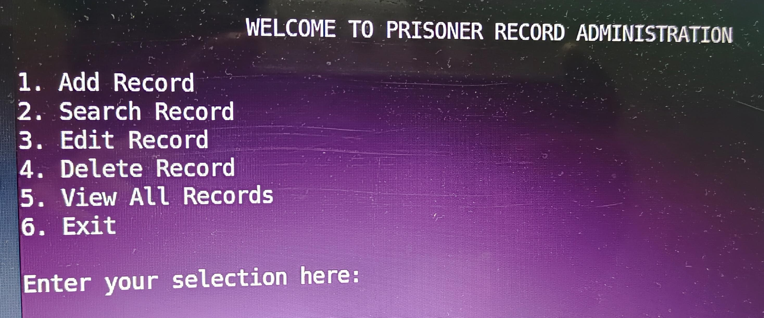
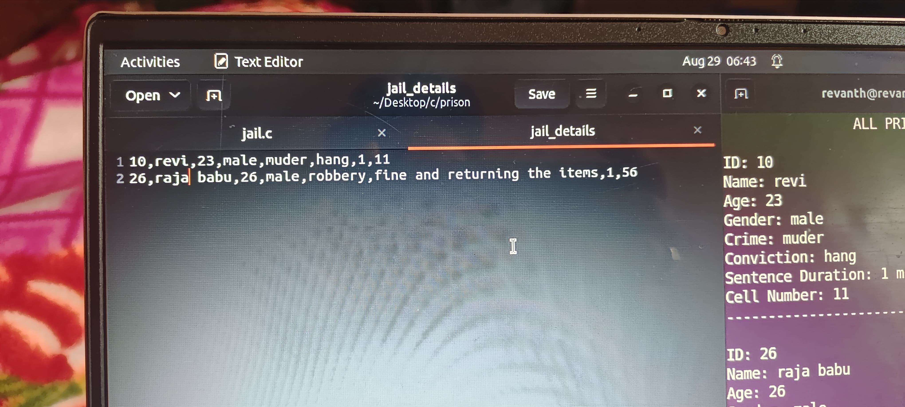
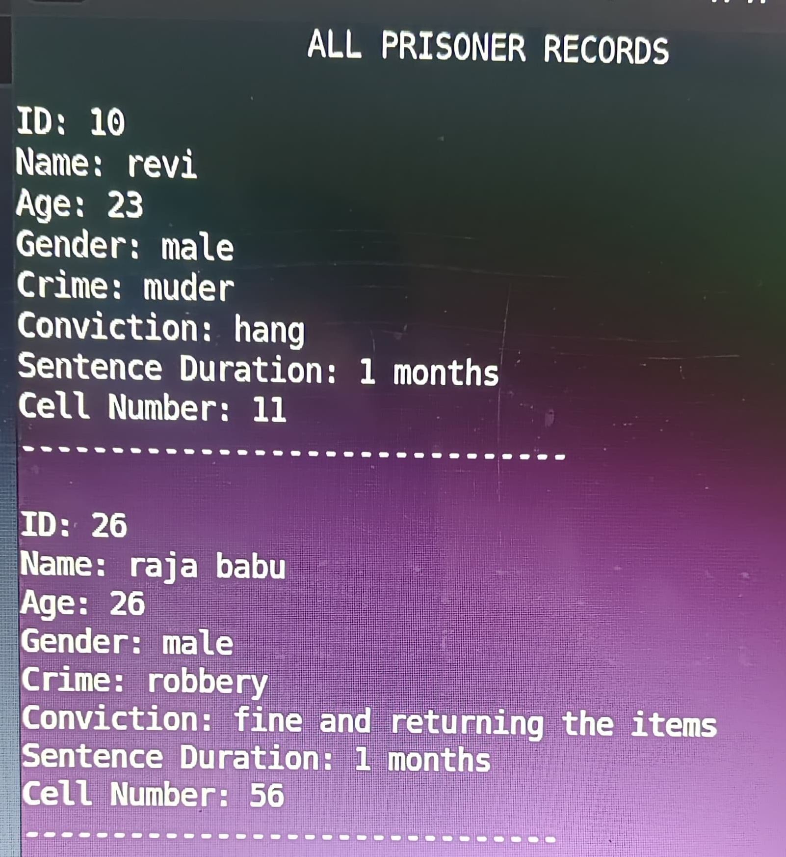
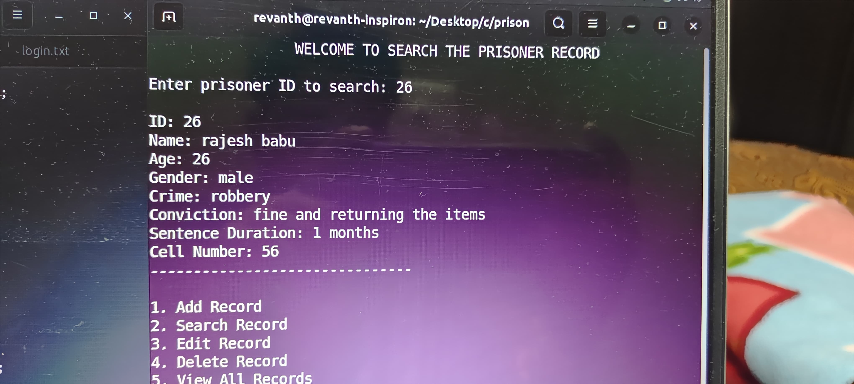
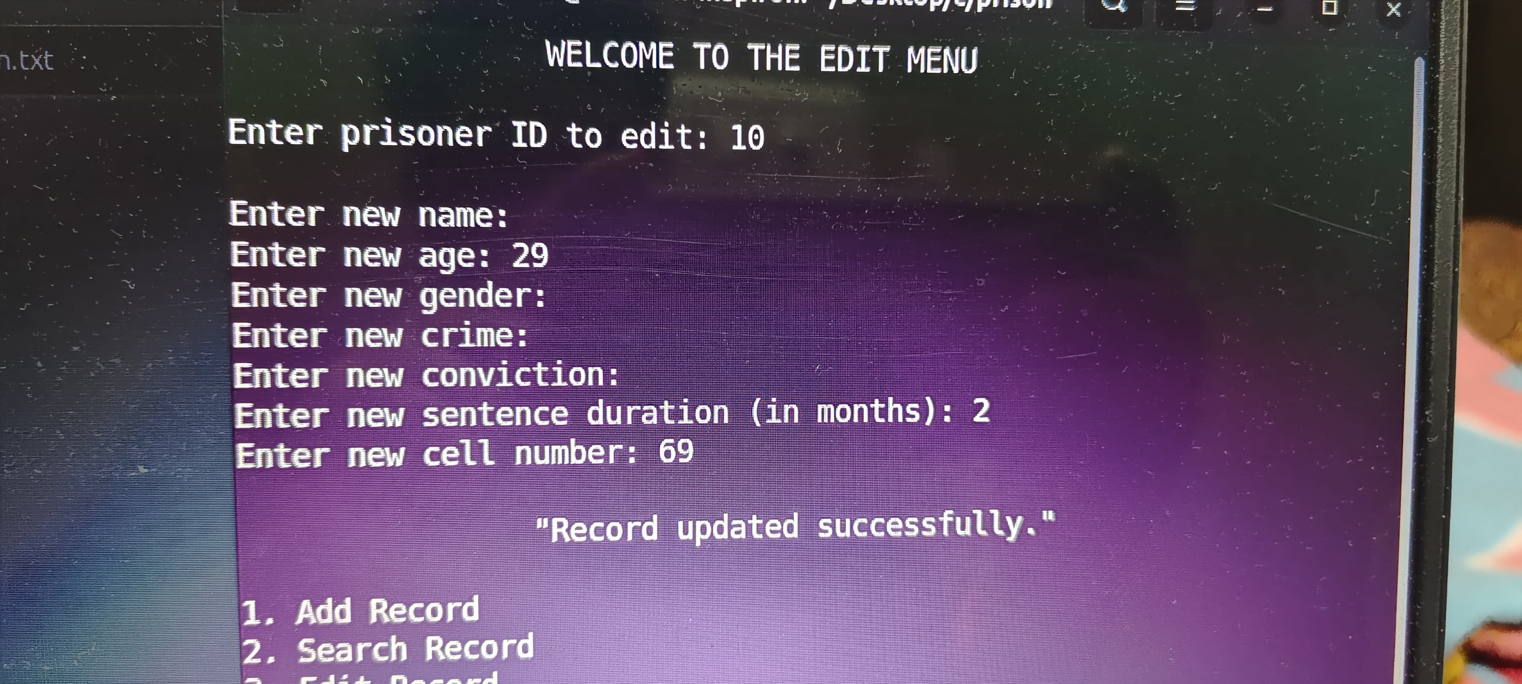
RESULTS
Fig: Display Menu
Fig: Add Record
Fig: Login Credentials After 3 Attempts
Fig: Data Stored in File
Fig: Search Record
Fig: Edit Record
Fig: View Record

Slide 10
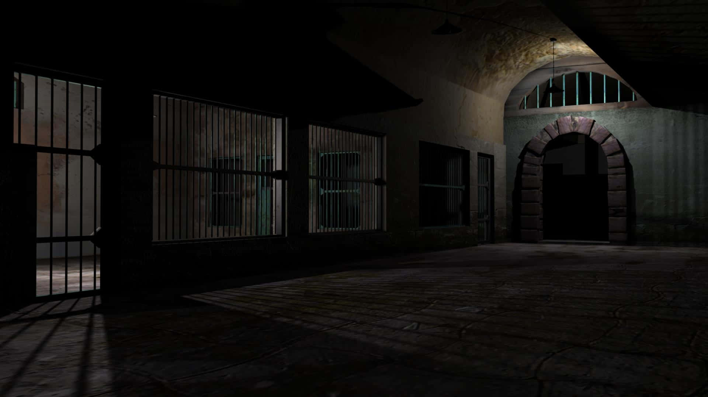
CONCLUSION
The Prisoner Information Portal is a simple and effective tool for managing prisoner records using a file-based approach. It offers essential features like adding, searching, editing, deleting, and View records through a command-line interface. While easy to implement and use, it could be enhanced with advanced security and data management for larger systems.

Slide 11



☺

